Slide 1
Mr. Zorayr Karapetyan, Ph.D. Deputy Head of Methodology and International Relations Department July 4-5, 2017, Lisbon, Portugal
CHAMBER OF CONTROL (SAI) REPUBLIC OF ARMENIA

Slide 2
DEVELOPMENT STAGES
CONSTITUTION ADOBTED IN 1995
Established within the structure of the National Assembly of Armenia
CONSTITUTIONAL REFORMS IN 2005
Became an Independent State Body
CONSTITIONAL REFORMS IN 2015 (CURRENT STAGE)
Chamber of Control transforms to Chamber of Audit
(from April, 2018)

Slide 3
TYPES OF AUDIT
EXTERNAL AUDIT
State and municipal budget funds and revenues
Use of the state and municipal property
Loan and grant projects
TYPES OF AUDIT
Financial audit
Compliance audit
Performance audit

Slide 4
SHIFT FROM INSPECTION TO AUDIT
RECENT ACHIEVMENTS
Annual Plan adopted by the SAI
Board members elected by the Parliament (at least 3/5 vote)
SAI staff members are not civil servants
Unlimited access to State IT systems and databases
Audit over budget execution statement is a preventive measure

Slide 5
SHIFT FROM INSPECTION TO AUDIT
CHALLENGES
Strengthening of Functional, Operational and Financial Independence
Implementation of national standards sound to ISSAIs
Implementation of Risk assessment system in Audit planning
Implementation of Quality control system
Engagement of Qualified audit staff

Slide 6
AUDIT RESULTS
REPORTING
the Parliament
the President
the Government
Available on the website: www.coc.am
The Prosecutor General’s Office (in case there are suspicions about criminal and legal violations)
FOLLOW-UP
The Chamber of Control
Follows-up the recovery process
gives recommendations on further preventions and improvements

Slide 7
PUBLIC PROCUREMENT AUDIT
FINDINGS
HIGH PRICING
INTERMEDIARY SUPPLY
INEFFICIENT PLANNING
UNSUBSTANTIATED BUDGET ESTIMATION
SINCE 2013 - PUBLIC PROCUREMENT AUDIT IS STATED AS A HIGH PRIORITY AUDIT TOPIC

Slide 8
PUBLIC PROCUREMENT AUDIT
RECENT AUDIT RECOMMENDATIONS
improvement of legal framework
raising awareness, transparency and level of competition
implementation of e-procurement system
improvement of pricing and budget estimation mechanisms
OUTCOME
Complex review of legal acts
More detailed pricing and budget estimation mechanisms
More systematic approach to Anticorruption activities were accepted
1.5 million USD saved in Healthcare (2014)

Slide 9
ANTI CORRUPTION ACTIVITIES
Exclusion of the interconnection between participants
Transparency
Raising the level of awareness
Functional and institutional changes
Exclusion of the conflict of interest in terms of decision making process
ACTIVITIES

Slide 10
RESPONSIBILITY
A BIDDER
AN OFFICIAL
Mechanisms of exclusion of interconnections
Disclosure mechanisms
of real shareholders
Mechanisms for exclusion
of conflict of interests
1.
2.
3.
.
Bring to responsibility
stipulated by the Law
Black list

Slide 11
REDUCTION OF PROCUREMENT METHODS
Old law
New law
7
4
Open procedure
Simplified procedure
Negotiation procedure by initially publishing procurement announcement
Negotiation procedure without initially
publishing procurement announcement
Competitive dialogue
Restricted procedure
Procurements carried out under framework
agreements
e-Auction
Competition
Request for Quotation
Single Source procurement

Slide 12
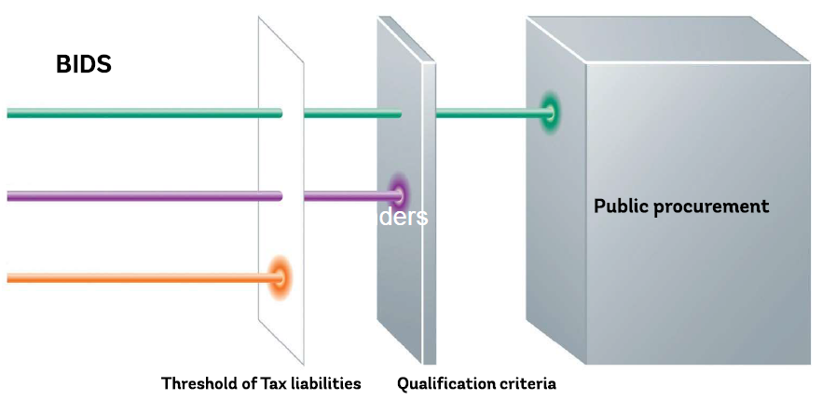
RAISING THE LEVEL OF COMPETITION

Slide 13
MEDIA REVIEW
Transparency International Annual Report 2015:
“Chamber of Control remains the main pillar for the integrity in Armenian public procurement system”

Slide 14
THANK YOU!
Mr. Zorayr Karapetyan, Ph.D. Deputy Head of Methodology and International Relations Department, Chamber of Control of the Republic of Armenia
e-mail: intrel@cocmail.am

